Slide 1
Online Attendance Management System
Guided by : Professor Llesh Milaj
Developed By: Sarjakkumar Kothiya, Vaibhav Babariya,
Nikunj Chavda, Vaishali Laveti, Akshay Dhakan

Slide 2
System Definition :
The Online Attendance Management System is a web-based system for attendance management. It is an application developed for student daily attendance in college or school. It helps to maintain records of both staff and students.
System Objective :
It's time-saving as manual work is minimized. It eliminates duplicate data entry both in time and with new entries. Easy access for staff and students as they can view and update their data. Staff can also easily access student data according to their needs
Scope :
In the present situation, the system can be accessed on both PC and mobile devices. The scope of the project extends to any mobile device with access to its server on which the project has been deployed. It is developed as a web application and will work for a particular institute. In the future, we make the system can be automated using students' fingerprints.

Slide 3
System Requirement :
Number | Description | Type
1 | Operating System | Windows
2 | Language | PHP
3 | Server side script | PHP Script
4 | Client side script | Java Script , HTML
5 | Server | XAAMP
6 | Database | MySQL
7 | Text Pad | Sublime
8 | Designing Tools | HTML CSS
9 | Browser | Internet Explorer/Mozilla etc

Slide 4
Expected working of system :
Role of staff :
Login←→Logout
Add student
Add fields
Edit data
View student list
Take attendance
Role of student :
Register
Login←→Logout
Update data
Forgot password?
Change password

Slide 5
Process Specification :
A process specification is a method used to document , analyse and explain the decision-making logic and formulas used to create output data from process input data. Its objective is to flow down and specify regulatory requirements and procedures, high-quality , consistent data require clear and complete process specifications.
1. Staff Module :
Process 1.1 : Log in
The teachers and staff members can login into the System by using unique username and password from general login form general Login Form.
Process 1.2 : Registration
If there is new user they can register their data.
Process 1.3 : Operations
1. Members can change their data it means update option is also available.
2. Teacher can view their student list.
3. If any one forgot their password they can update their password with unique OTP providing by system.

Slide 6
2. Student Module :
Process 2.1 : Log in
The students can login into the System by using unique username and password from general login form general Login Form.
Process 2.2 : Registration
If there is new user they can register their data.
Process 2.3 : Operations
1. Members can change their data it means update option is also available.
2. If any one forgot their password they can update their password with unique OTP providing by system.

Slide 7
Database design :
1. Admin :
Fields | Datatype | Length
Id | Int | 20
Fname | Varchar | 20
Lname | Varchar | 20
Bdate | Date
Age | Int | 4
Mnumber | Int | 10
Mail | Varchar | 20
Address | Varchar | 50

Slide 8
2. Staff :
Fields | Datatype | Length
Id | Int | 20
Fname | Varchar | 20
Lname | Varchar | 20
Bdate | Date
Age | Int | 4
Mnumber | Int | 10
Mail | Varchar | 20
Qualification | Varchar | 5
Field | Varchar | 10
Subject | Varchar | 10
Address | Varchar | 50
Password | Varchar | 10

Slide 9
3. Student :
Fields | Datatype | Length
Id | Int | 11
Fname | Varchar | 20
Lname | Varchar | 20
Bdate | Date
Age | Int | 4
Mnumber | Int | 10
Mail | Varchar | 20
Field | Varchar | 10
Address | Varchar | 50
Password | Varchar | 10

Slide 10
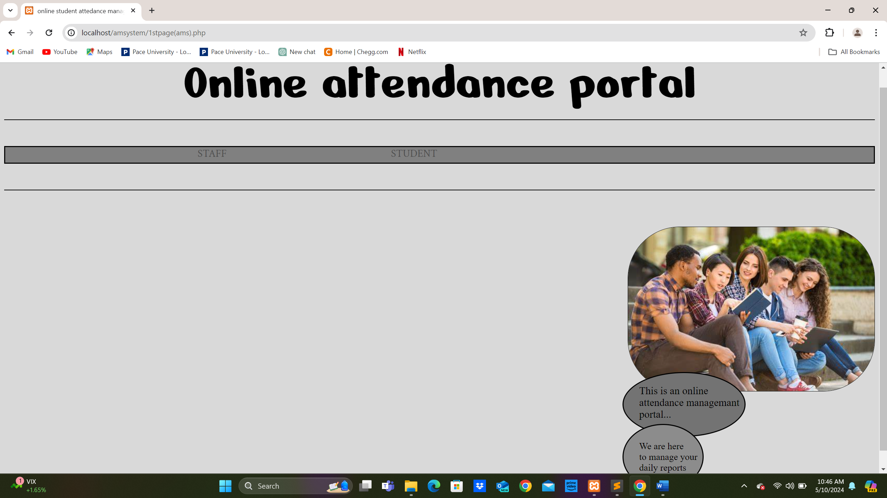
Main Page:

Slide 11
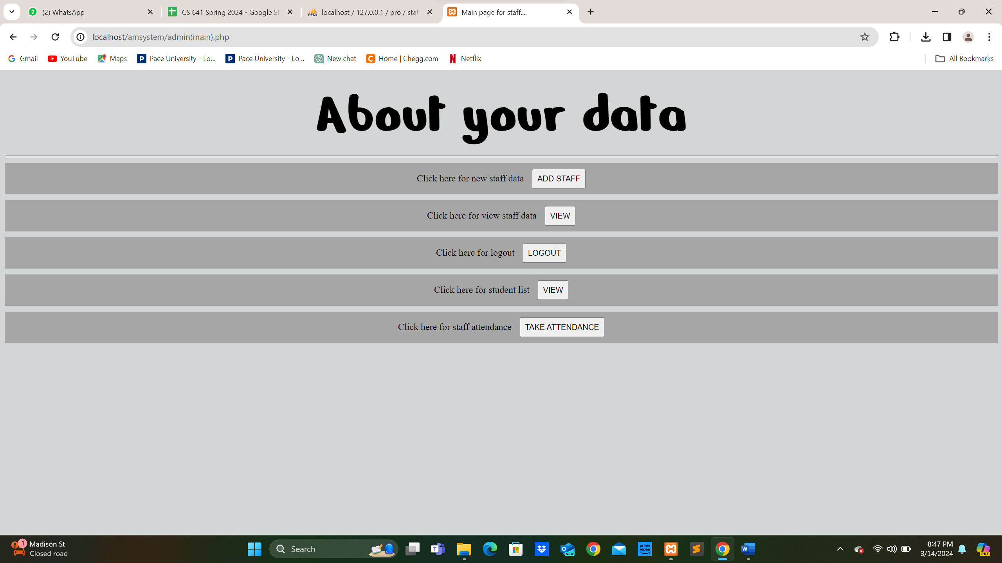
Screenshots :
Login page functionality is accessible by admins, staff, and students with their respective usernames and passwords. If the entered username or password is incorrect, the user cannot log in.

Slide 12
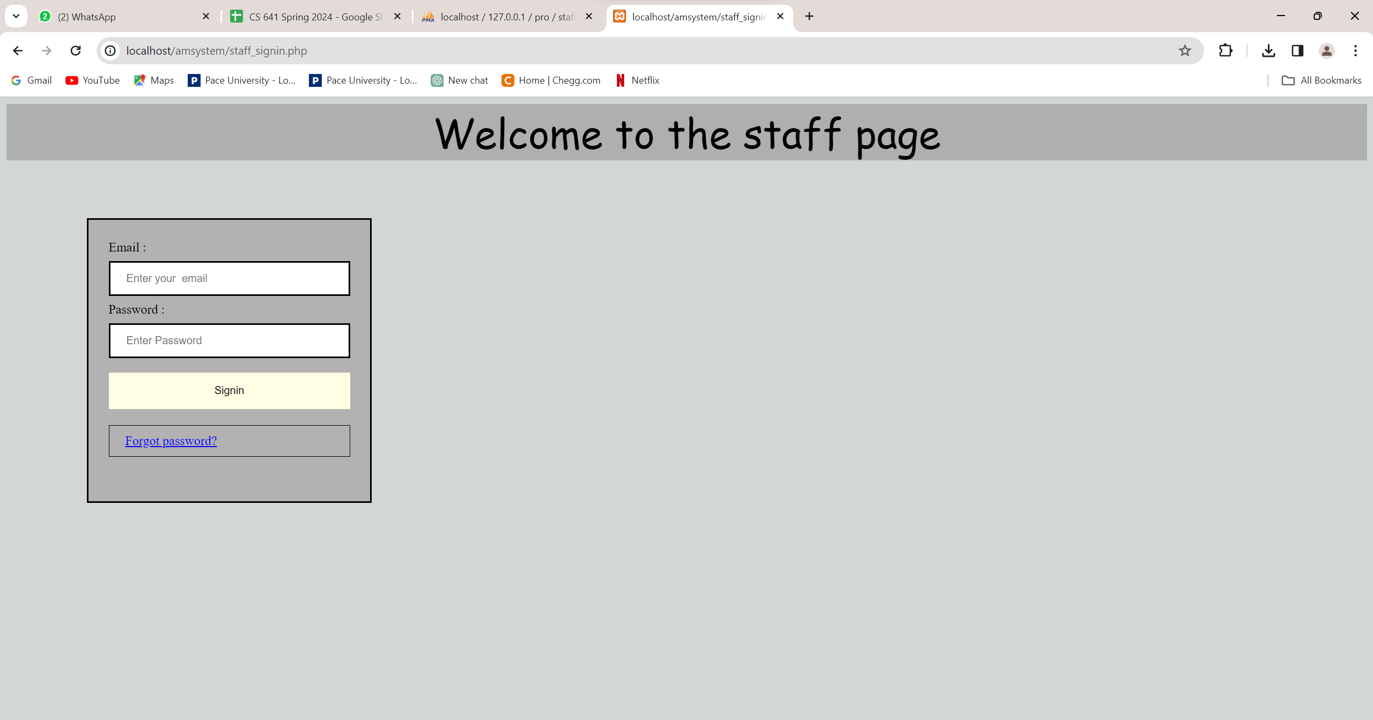

Slide 13
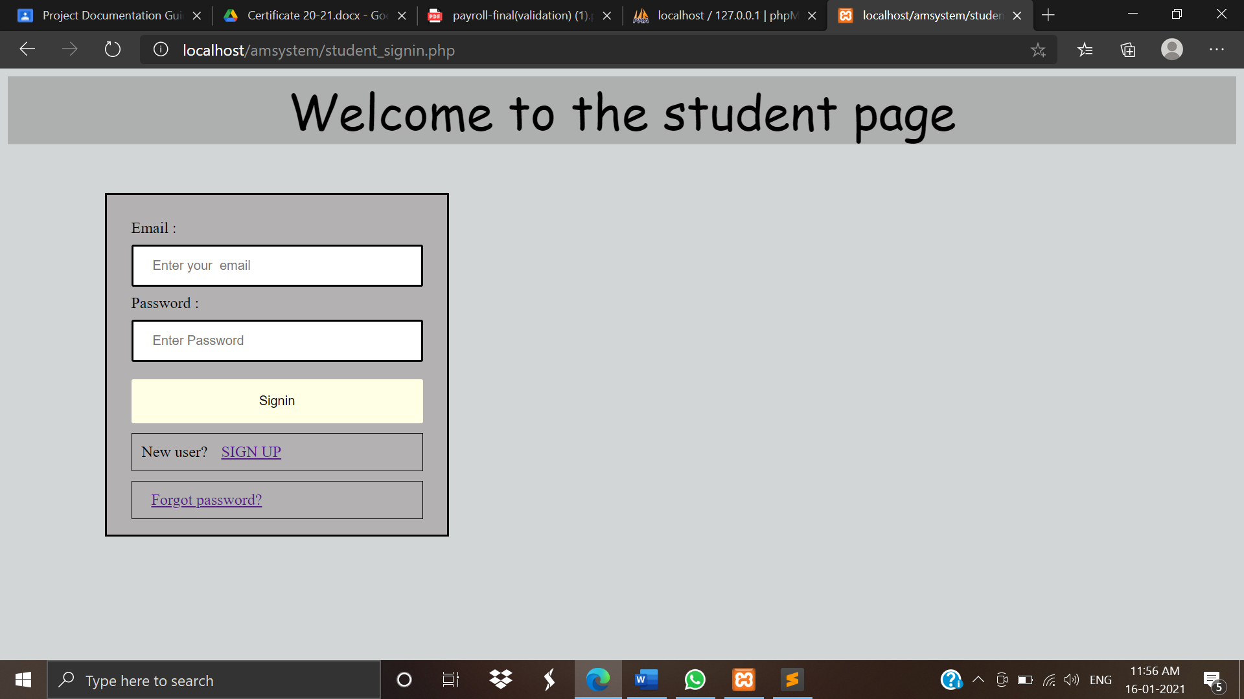

Slide 14
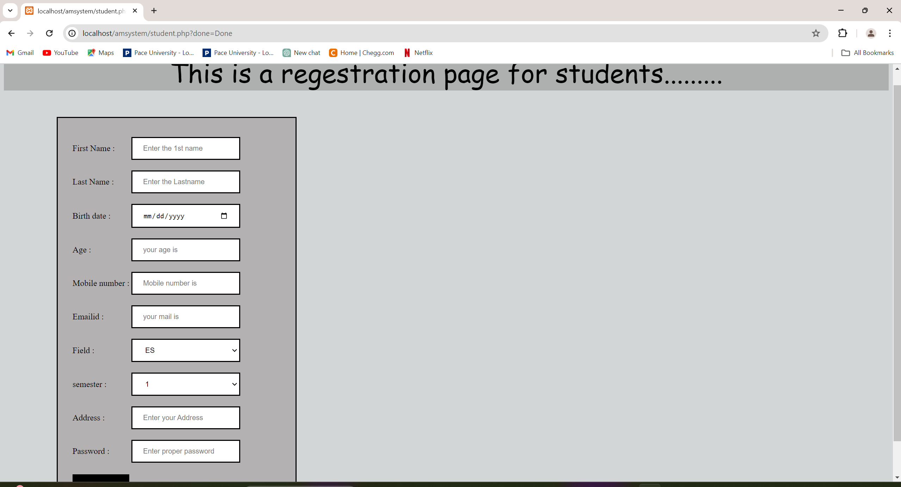
Registration Page:

Slide 15
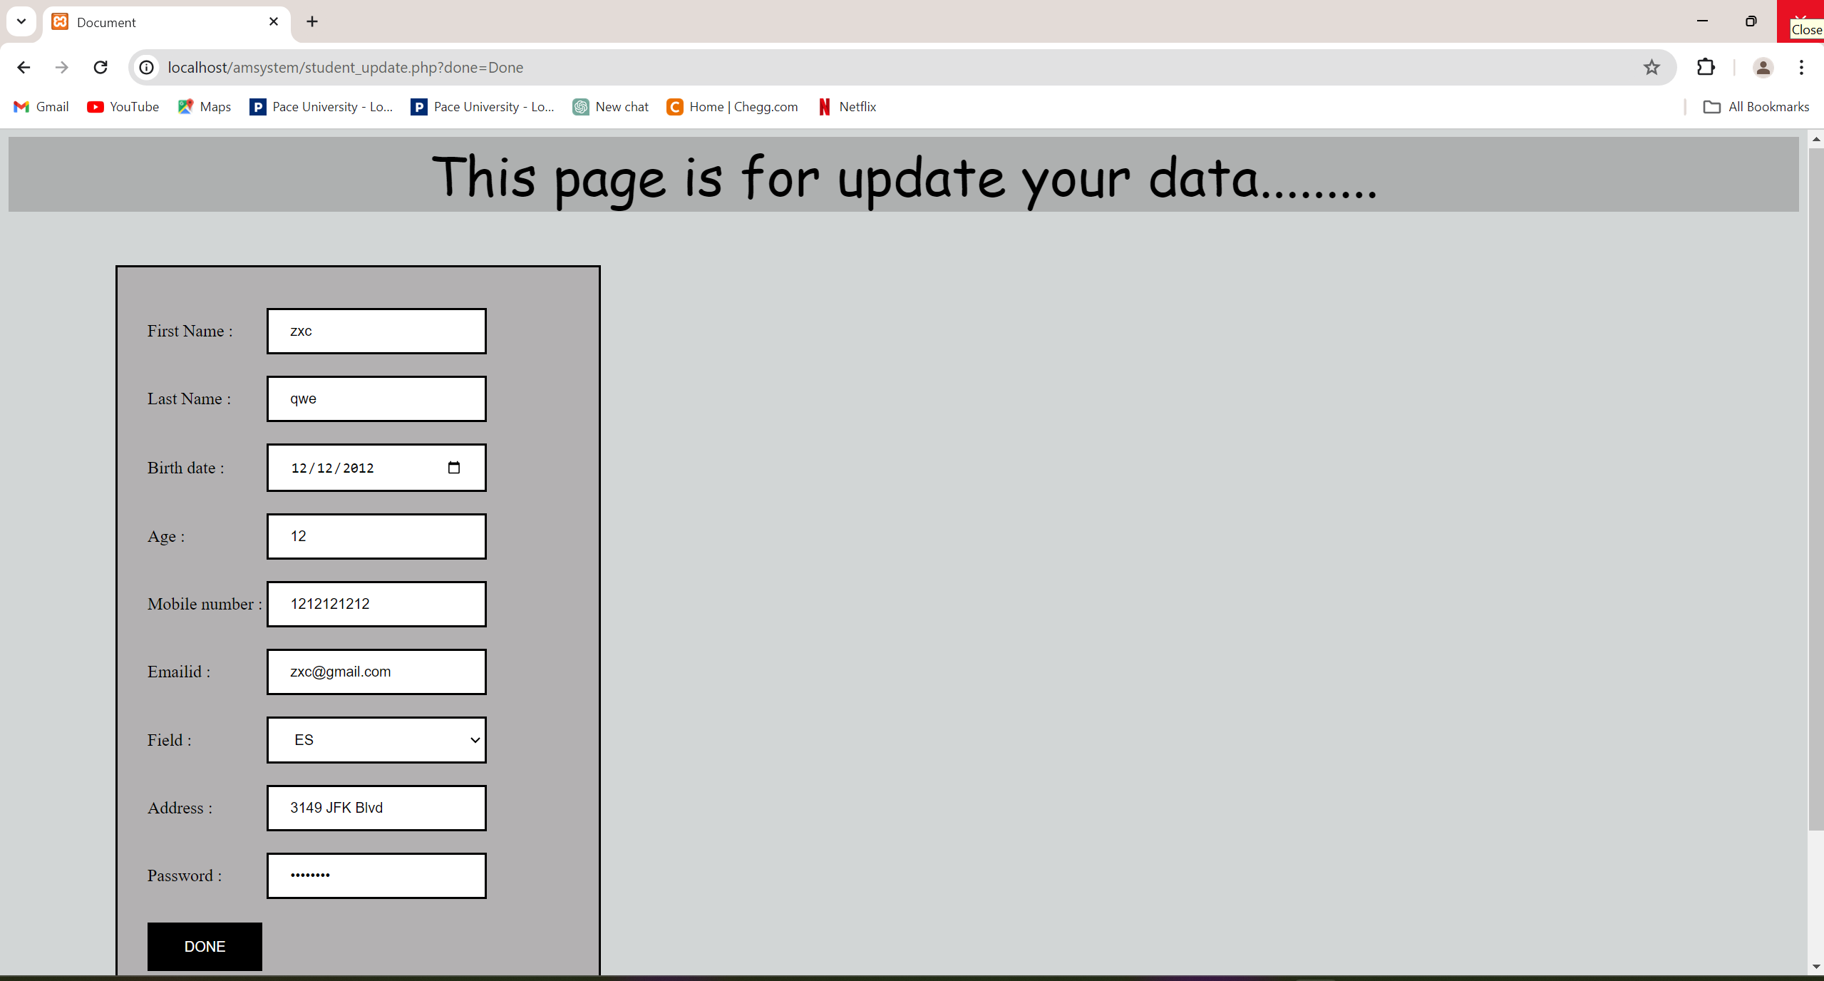
Modify the data:

Slide 16
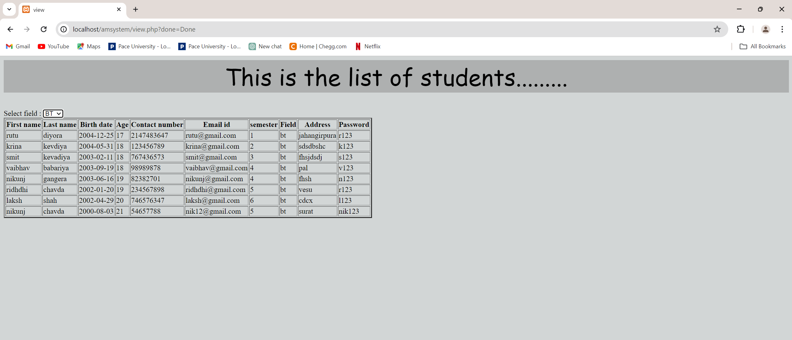
List of Students:

Slide 17
Examples of Testing data inputs & operations :
1. Login Page :
No. | Input | Description | Expected output | Actual output | Result
1 | Empty email | No input | error | error | Login failed
2 | Empty password | No input | error | error | Login failed
3 | Wrong email | Wrong email inputted | Login failed | Login failed | Login failed
4 | Wrong password | Wrong password inputted | Login failed | Login failed | Login failed
5 | Valid data | Valid data entered | Login done | Login done | PASS

Slide 18
2. New User Page for Staff :
No. | Input | Description | Expected output | Actual output | Result
1 | Id | Blank | Error | Error | Can’t submit
2 | Fname | Blank | Error | Error | Can’t submit
3 | Lname | Blank | Error | Error | Can’t submit
4 | Bdate | Blank | Error | Error | Can’t submit
5 | Age | Blank | Error | Error | Can’t submit
6 | Mnumber | Blank | Error | Error | Can’t submit
7 | Mail | Blank | Error | Error | Can’t submit
8 | Qualification | Blank | Error | Error | Can’t submit
9 | Field | Blank | Error | Error | Can’t submit
10 | Subject | Blank | Error | Error | Can’t submit
11 | Address | Blank | Error | Error | Can’t submit
12 | Password | Blank | Error | Error | Can’t submit

Slide 19
3. Edit Page for staff:
No. | Input | Description | Expected output | Actual output | Result
1 | Id | Blank | Error | Error | Can’t submit
2 | Fname | Blank | Error | Error | Can’t submit
3 | Lname | Blank | Error | Error | Can’t submit
4 | Bdate | Blank | Error | Error | Can’t submit
5 | Age | Blank | Error | Error | Can’t submit
6 | Mnumber | Blank | Error | Error | Can’t submit
7 | Mail | Blank | Error | Error | Can’t submit
8 | Qualification | Blank | Error | Error | Can’t submit
9 | Field | Blank | Error | Error | Can’t submit
10 | Subject | Blank | Error | Error | Can’t submit
11 | Address | Blank | Error | Error | Can’t submit
12 | Password | Blank | Error | Error | Can’t submit

Slide 20
NEW TOOLS/TECHNOLOGIES LEARNED/USED:
Sublime Text: Utilized as the primary development environment for coding.
PHP for validation purposes.
CSS for enhancing page designs.
XAMPP server setup to facilitate local development.
PhpMyAdmin employed for efficient database management using SQL.
SYSTEM LIMITATIONS/CONSTRAINTS:
This application requires an active internet connection and Wi-Fi availability for seamless operation.
The confirmation of application status relies solely on the availability of internet and Wi-Fi connections.
User registration is restricted to admin privileges, contingent upon the presence of data within the Admin detail table.

